Slide 1
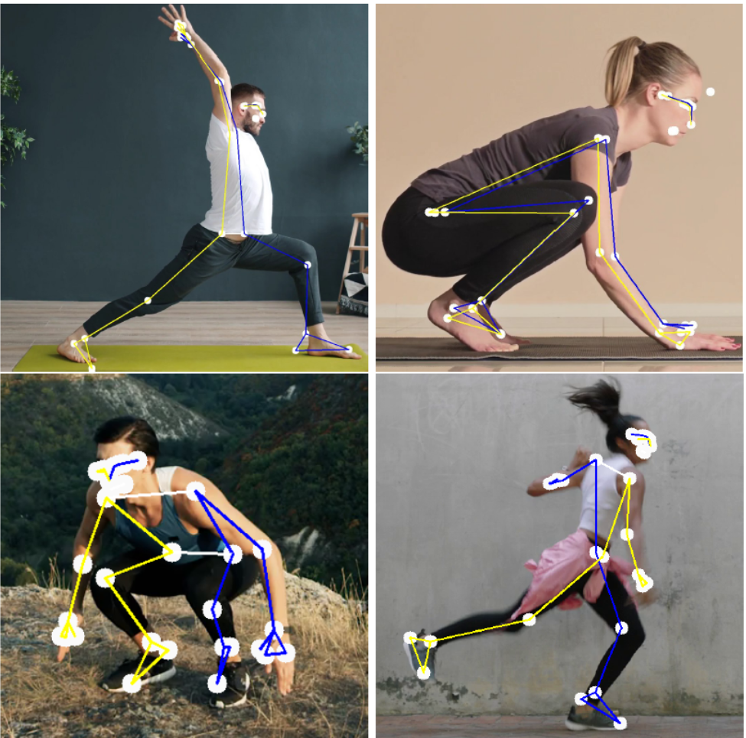
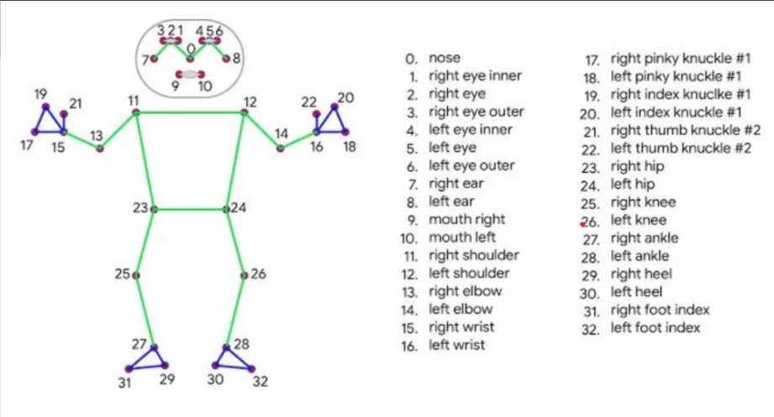
AI-enhanced Smart Physical Rehabilitation
Xian Gao, Molly Meadows, Noah Rieth
Value Proposition
Injury is prolonged due to improper completion of physical therapy exercises
Instead of paying extra money to see a physical therapist weekly:
We will attempt to create a model that gives feedback which includes:
How accurate
How you can improve
Current Objectives
Extract skeletal data from pictures and videos using existing python libraries:
PoseFormerV2
BlasePose
VideoPose3D
OpenPose
BlasePose
PoseFormerV2

Slide 2
AI-enhanced Smart Physical Rehabilitation
Xian Gao, Molly Meadows, Noah Rieth
Introduction of BlasePose
Human pose estimation based on images or videos plays a crucial role in various applications such as health tracking, sign language recognition, and gesture control. The current standard for human body pose is the COCO topology, consisting of 17 key points spanning across the torso, arms, legs, and face.
Expceted results of BlasePose

